Slide 1


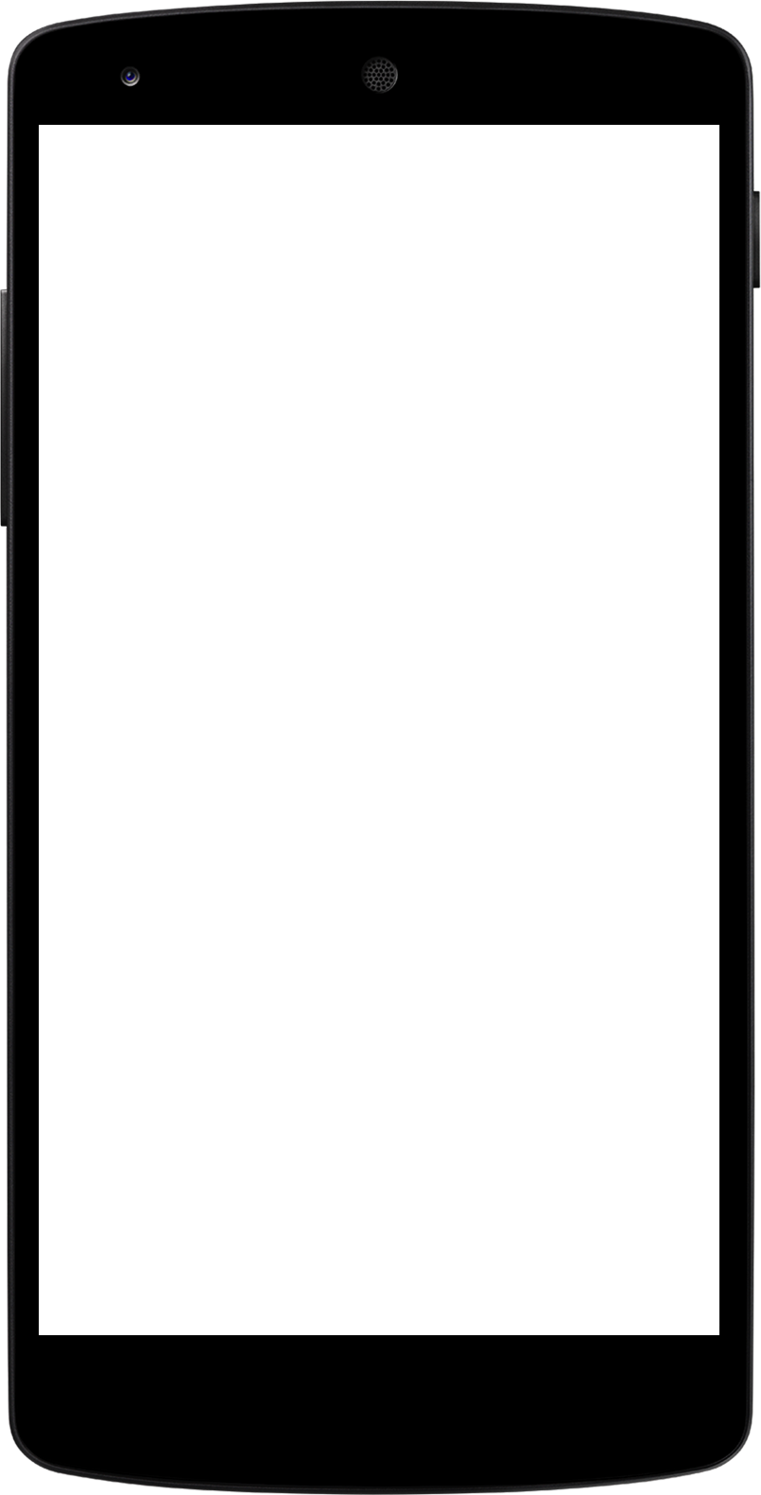
Capstone Project Presentation
Team Members:
Sahithi
Anjali
Sayan
Geetha

Slide 2



Outline
Problem Statement
Objective
Microservices
Project Overview
Architecture
Application Flow
Technology and Tools Used
Future Modifications
Conclusion

Slide 3
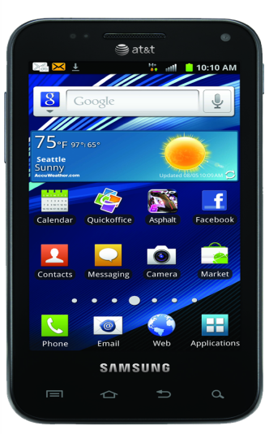
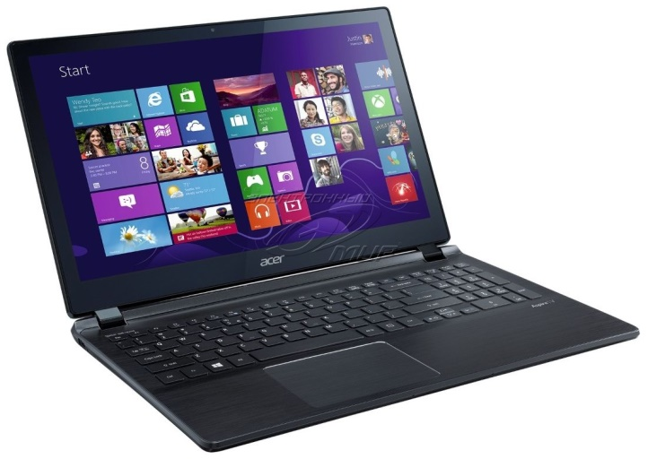
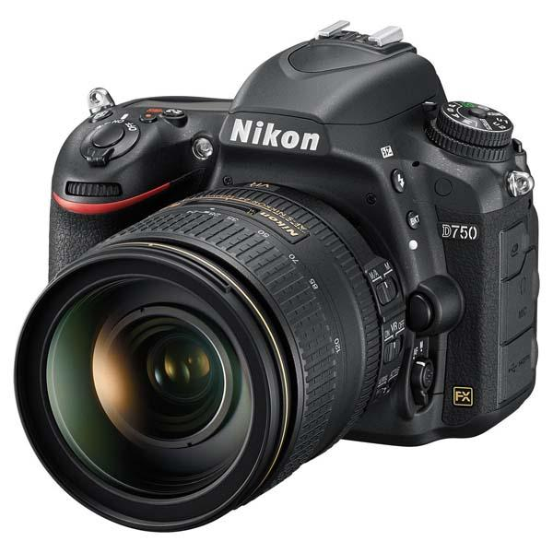
Problem Statement
X is like all of us. Tech-Savvy. X wants to know about the latest gadgets and accessories which are personalized, bearing relevant promotional offers and also wishes to see attractive deals in one go. TechZen caters to all of X’s tech needs.

Slide 4
Objective
To implement our knowledge of ASP.NET Core MVC and WebAPI to make a responsive E-commerce Electronics Store Website using Azure Services like SQL Server, Storage Accounts and subsequent Web Deployment.
TechZen implements both Admin and User role based modules to perform different operations and provides access to a wide range of products and the best user experience to X and others.

Slide 5
Microservices
Entity Framework
ASP.NET Core
Azure Storage Account
Azure SQL

Slide 6

Project Overview
Login Validation
User
Admin CRUD Operations
Products View
Login
Home
Admin
Register
Azure
SQL
RestAPI
TechZenServer

Slide 7
Architecture
Models
Entities
Repository
User
Login
Product
DB Context
Views
Front End
MVC
Home
Login
User
Admin
Controllers
Design
Layout
Actions
Front End
WebAPI
Swagger
Get All Products
GET
External API

Slide 8
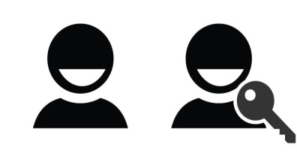
Application Flow
Home
Sign-Up
Sign-In
Register
ADMIN
USER
View Users
View Products
tblUser
Delete Users
My Cart
View Products
Order Summary
Add Products
Delete my account
Delete Products
tblProducts
Update Products

Slide 9









Tools and Technologies Used

Slide 10
Future Modifications
Multiple Add to Cart functionality.
Better designing and app development.
Use of Restful APIs for CRUD Operations.

Slide 11
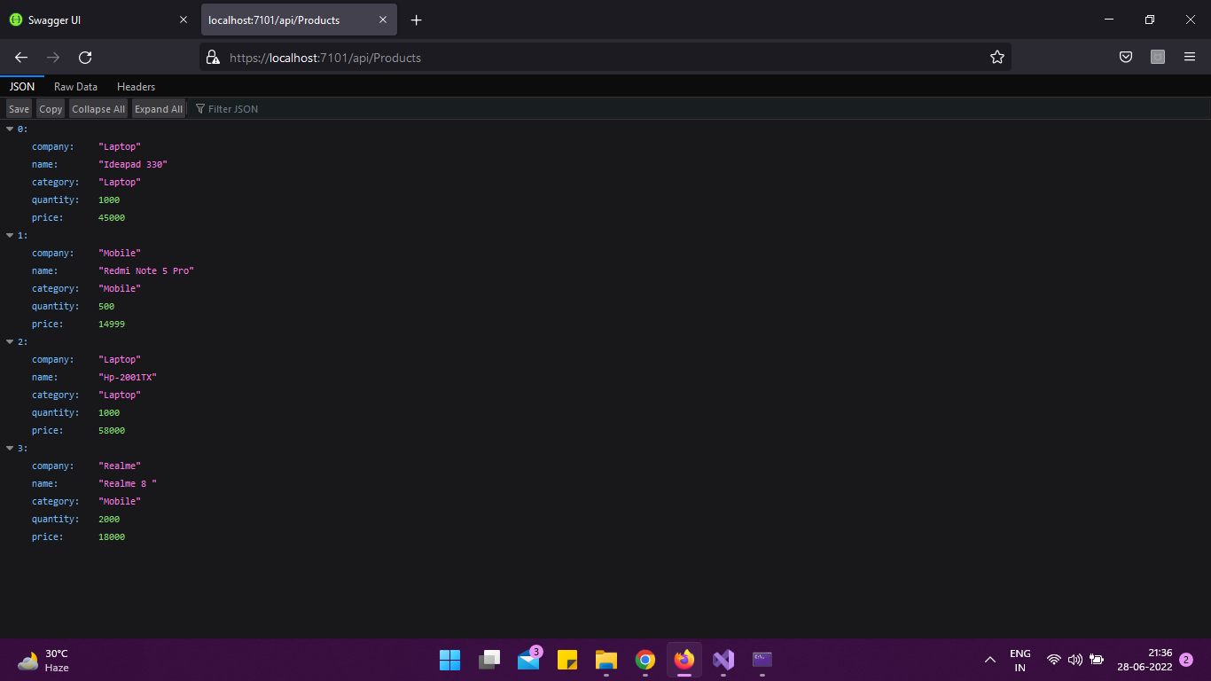
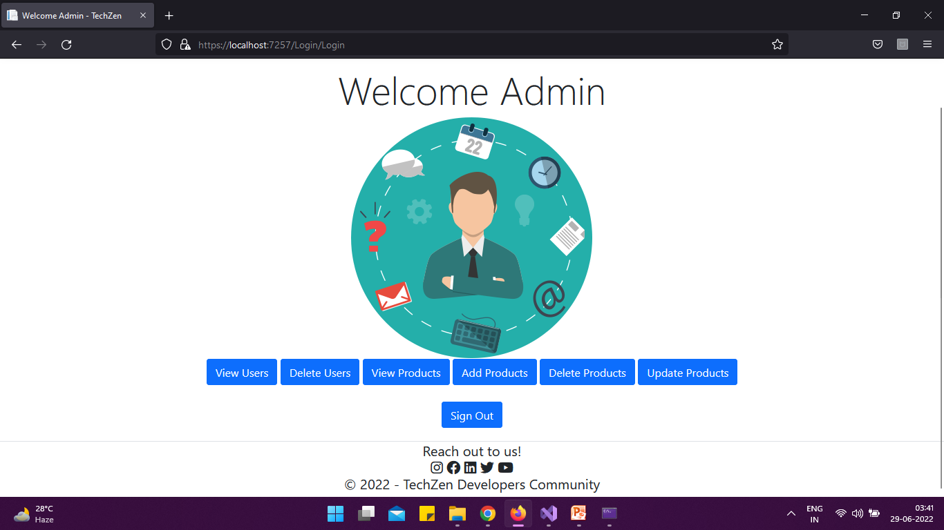
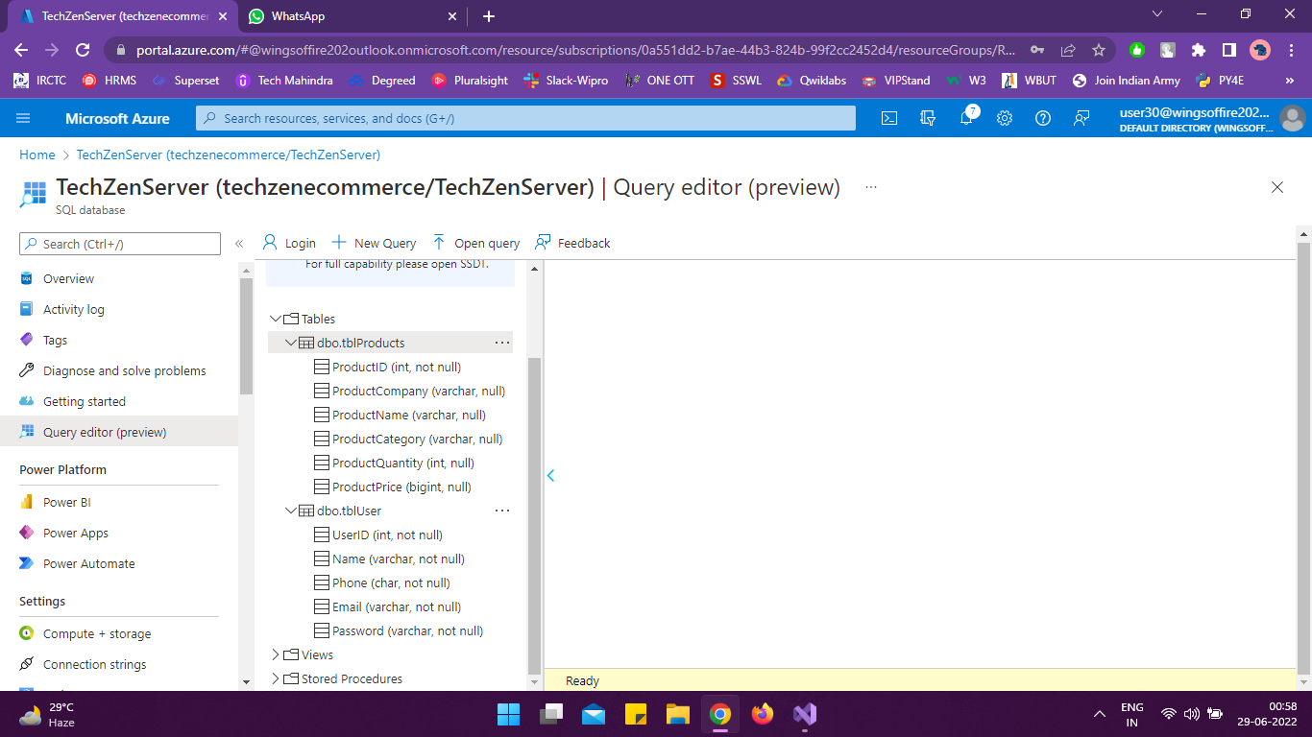
Some Snippets:

Slide 12
Conclusion
ASP.NET Core provides an easy way of creating Web Applications for your startup and the Azure Services help in easy deployment.
Online shopping has opened up doors to many small retailers that would never be in business if they had to incur the high cost of owning a brick and mortar store. At the end, it has been a win-win situation for both consumer and sellers.
TechZen provides an ease of access for users of all age groups alike to view and buy electronic accessories and gadgets.

Slide 13

THANK YOU

Slide 14

Time for some Q & A’s

